Slide 1
Intersectionality & Dialogue
Kesia Otieno

Slide 2
AGENDA
Introduction​
Purpose
DuVernay Test
​Question/Hypothesis/Significance Level
Methods​
Results
Discussion/Conclusion + Questions

Slide 3
Introduction
Saturation of Media Content
Trends of Pointing out Diversity
Intersectionality
Sexuality
Disability
Class
Age
Gender
Purpose/Focus: Insight on Gender + Race and Words Spoken in Film

Slide 4
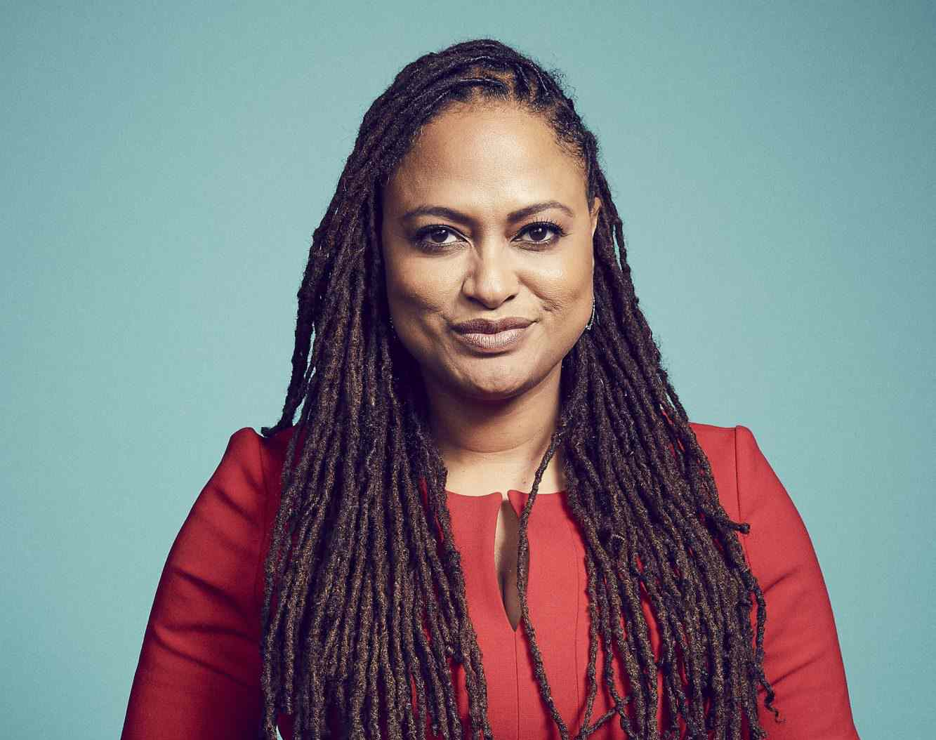
DuVernay test
Presence of racially diverse characters in films
Speaking Parts
Monologue
Dialogue
Complex Characters
Not in a relationship
Have lives not directly tied to a white character
Names
A role
While I won’t be using the Test, it provides some background to the importance of dialogue/monologue (speaking roles) in film.
https://people.com/movies/ava-duvernay-exclusion-of-women-minorities-in-hollywood-intentional/

Slide 5



Research Question, Hypothesis, Significance level
Research Question
Hypothesis
Significance level
Does the combination of gender and race have a significant impact on the amount of words spoken by a character?
H0 : There is no relationship between the intersection of Gender+Race and Polygraph Word Count.
H1 : There is a relationship between the intersection of Gender+Race and Polygraph Word Count.
α = .05

Slide 6
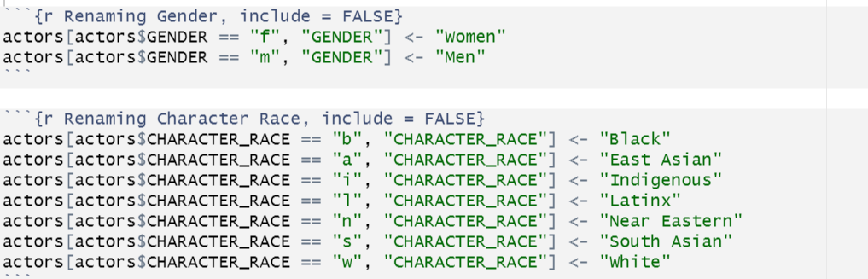
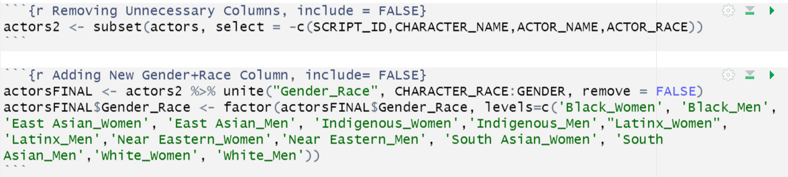
Methods – Data Transformation

Slide 7
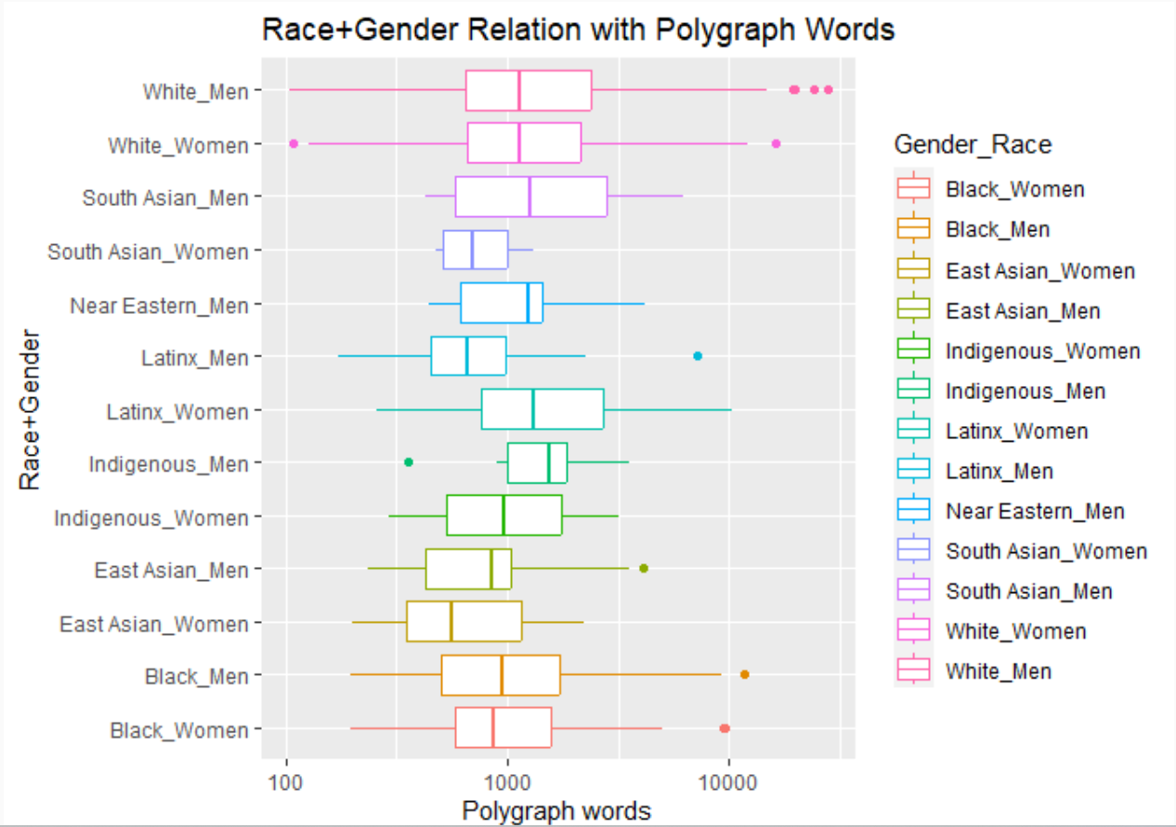
Box Plot
Continuous Variable
Categorical Variable
https://www.data-to-viz.com/

Slide 8
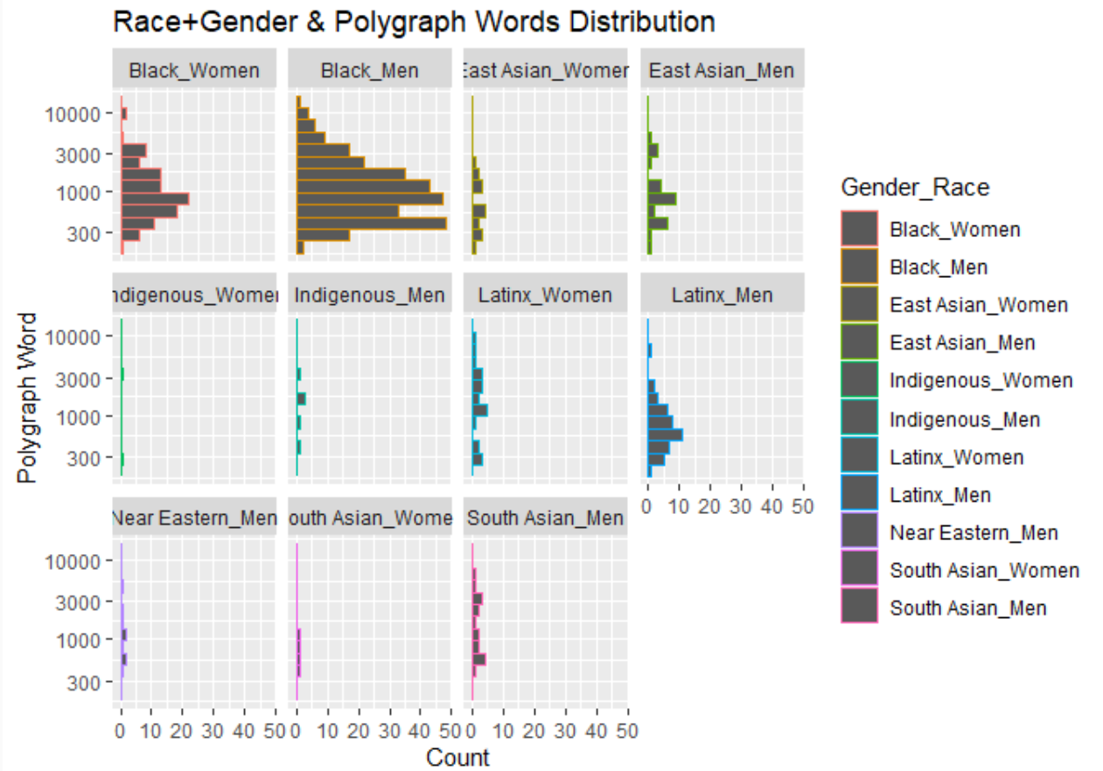
Is it normal ?
Shapiro- Wilkes Test
Histograms

Slide 9
Methods cont..
Mann Whitney U Test
Due to my data not having a normal distribution I sought out a Non-Parametric Analysis to compare outcomes between two independent variables. I opted for a non-directional or two-tailed U-test as the possible directionality was not something I wanted to be specified
Non-Parametric
Comparing two Independent Variables
Two Tailed

Slide 10
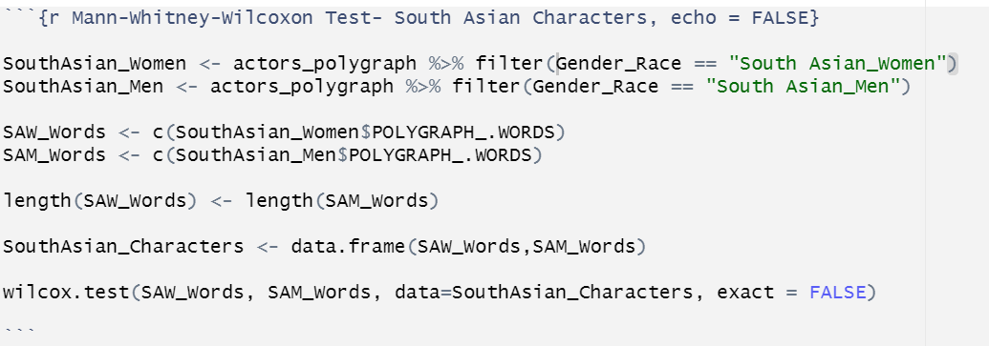
Methods – Data Transformation

Slide 11
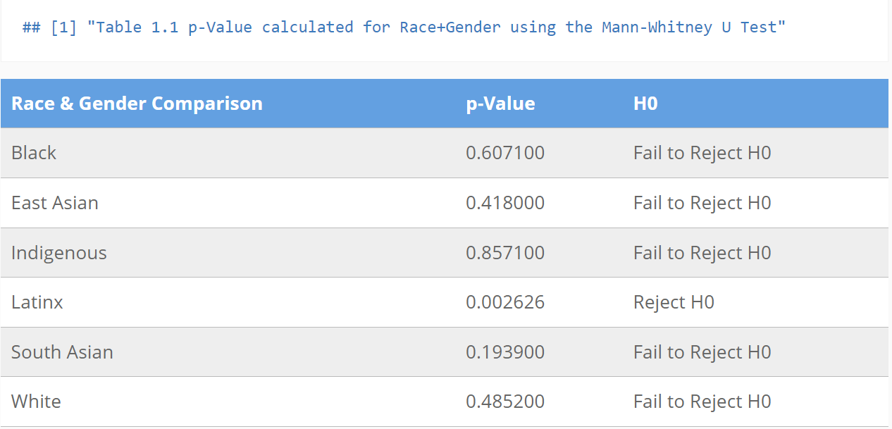
Mann Whitney U-Test Results

Slide 12
Limitations
Dataset
Movie Context
Outdated (1974 – 2014)
Missing Values (when comparing Gender within race)
Length function
No Near Eastern Women
Continuous Data Transformation
A character speaks very few words but it is essential if not central to the plot of the movie.
Real life actor does not match character – Birth of a Nation
Beginner Statistician
I have just begun to learn statistics so my analysis may not be as in-depth and analytical as it could be but I hope you got some type of insight.
Code > Statistics

Slide 13
SUMMARY
For this study, the results support that there is a relationship between Gender+Race and polygraph word count only for Latinx characters.
With the current data I found, so far we have information on the demographics of characters, age, and extracted words. In the future more data is needed on maybe the fiscal success of the films, films including Near Eastern Women, the ratings, and the amount of dialogue that was pertinent to the character’s story only.

Slide 14
Bibliography
Anderson, Hanah, and Matt Daniels. 2016. Film Dialogue: The Largest Ever Analysis of Film Dialogue. The Pudding.
Erigha, Maryann. 2015. “Race, Gender, Hollywood: Representation in Cultural Production and Digital Media’s Potential for Change.” Sociol. Compass 9 (1): 78–89.
Gray, J R A T. 2016. Diversity in Hollywood: Failure of Inclusion Plagues the Entire Industry. Variety Magazine. New York City: Variety. Web.
Jurgensen, John. 2023. “How Much Does John Wick Actually Say? We Counted the Words — Wsj.com.” https://www.wsj.com/articles/john-wick-chapter-four-keanu-reeves-dialogue-a1566ca3.
Massie, Victoria M. 2016. “Want to Measure a Film’s Diversity? Try "the Duvernay Test.".” Vox. Vox. https://www.vox.com/2016/2/1/10888212/duvernay-test-movie-diversity.
Ross, Shawna. n.d. “A Bechdel Test for# MLA16.”
Smith, Stacy L, Marc Choueti, and Katherine Pieper. 2007. Inequality in 900 Popular Films: Examining Portrayals of Gender, Race/Ethnicity, LGBT, and Disability from 2007-2016.
Sutherland, Jean-Anne, and Kathryn M Feltey. 2017. “Here’s Looking at Her: An Intersectional Analysis of Women, Power and Feminism in Film.” Journal of Gender Studies 26 (6): 618–31.
Svaikovsky, Victoria, Anne Meisner, Eve Kraicer, and Matthew Sims. 2018. “Racial Lines.” Harvard Dataverse. https://doi.org/10.7910/DVN/KERZQY.

Slide 15
THANK YOU
Kesia Otieno

